Slide 1
Introduction to Kubernetes
For Developers
#ossummit
@jasonvanbrackel

Slide 2
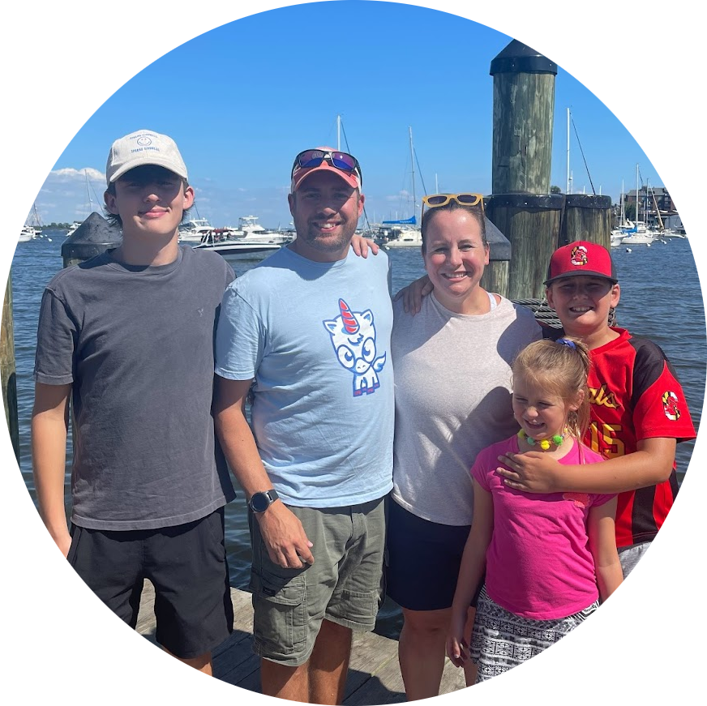





CONTACT ME
Jason van Brackel
Unicorn Engineer
@JvB
@jasonvanbrackel
jasonvanbrackel
#Zarf at https://slack.kubernetes.io
@defenseunicorns
Defense Unicorns

Slide 3
Agenda
Kubernetes
Concepts
Tools
Where can I get Started?
Kitchen Sink
What Else?

Slide 4
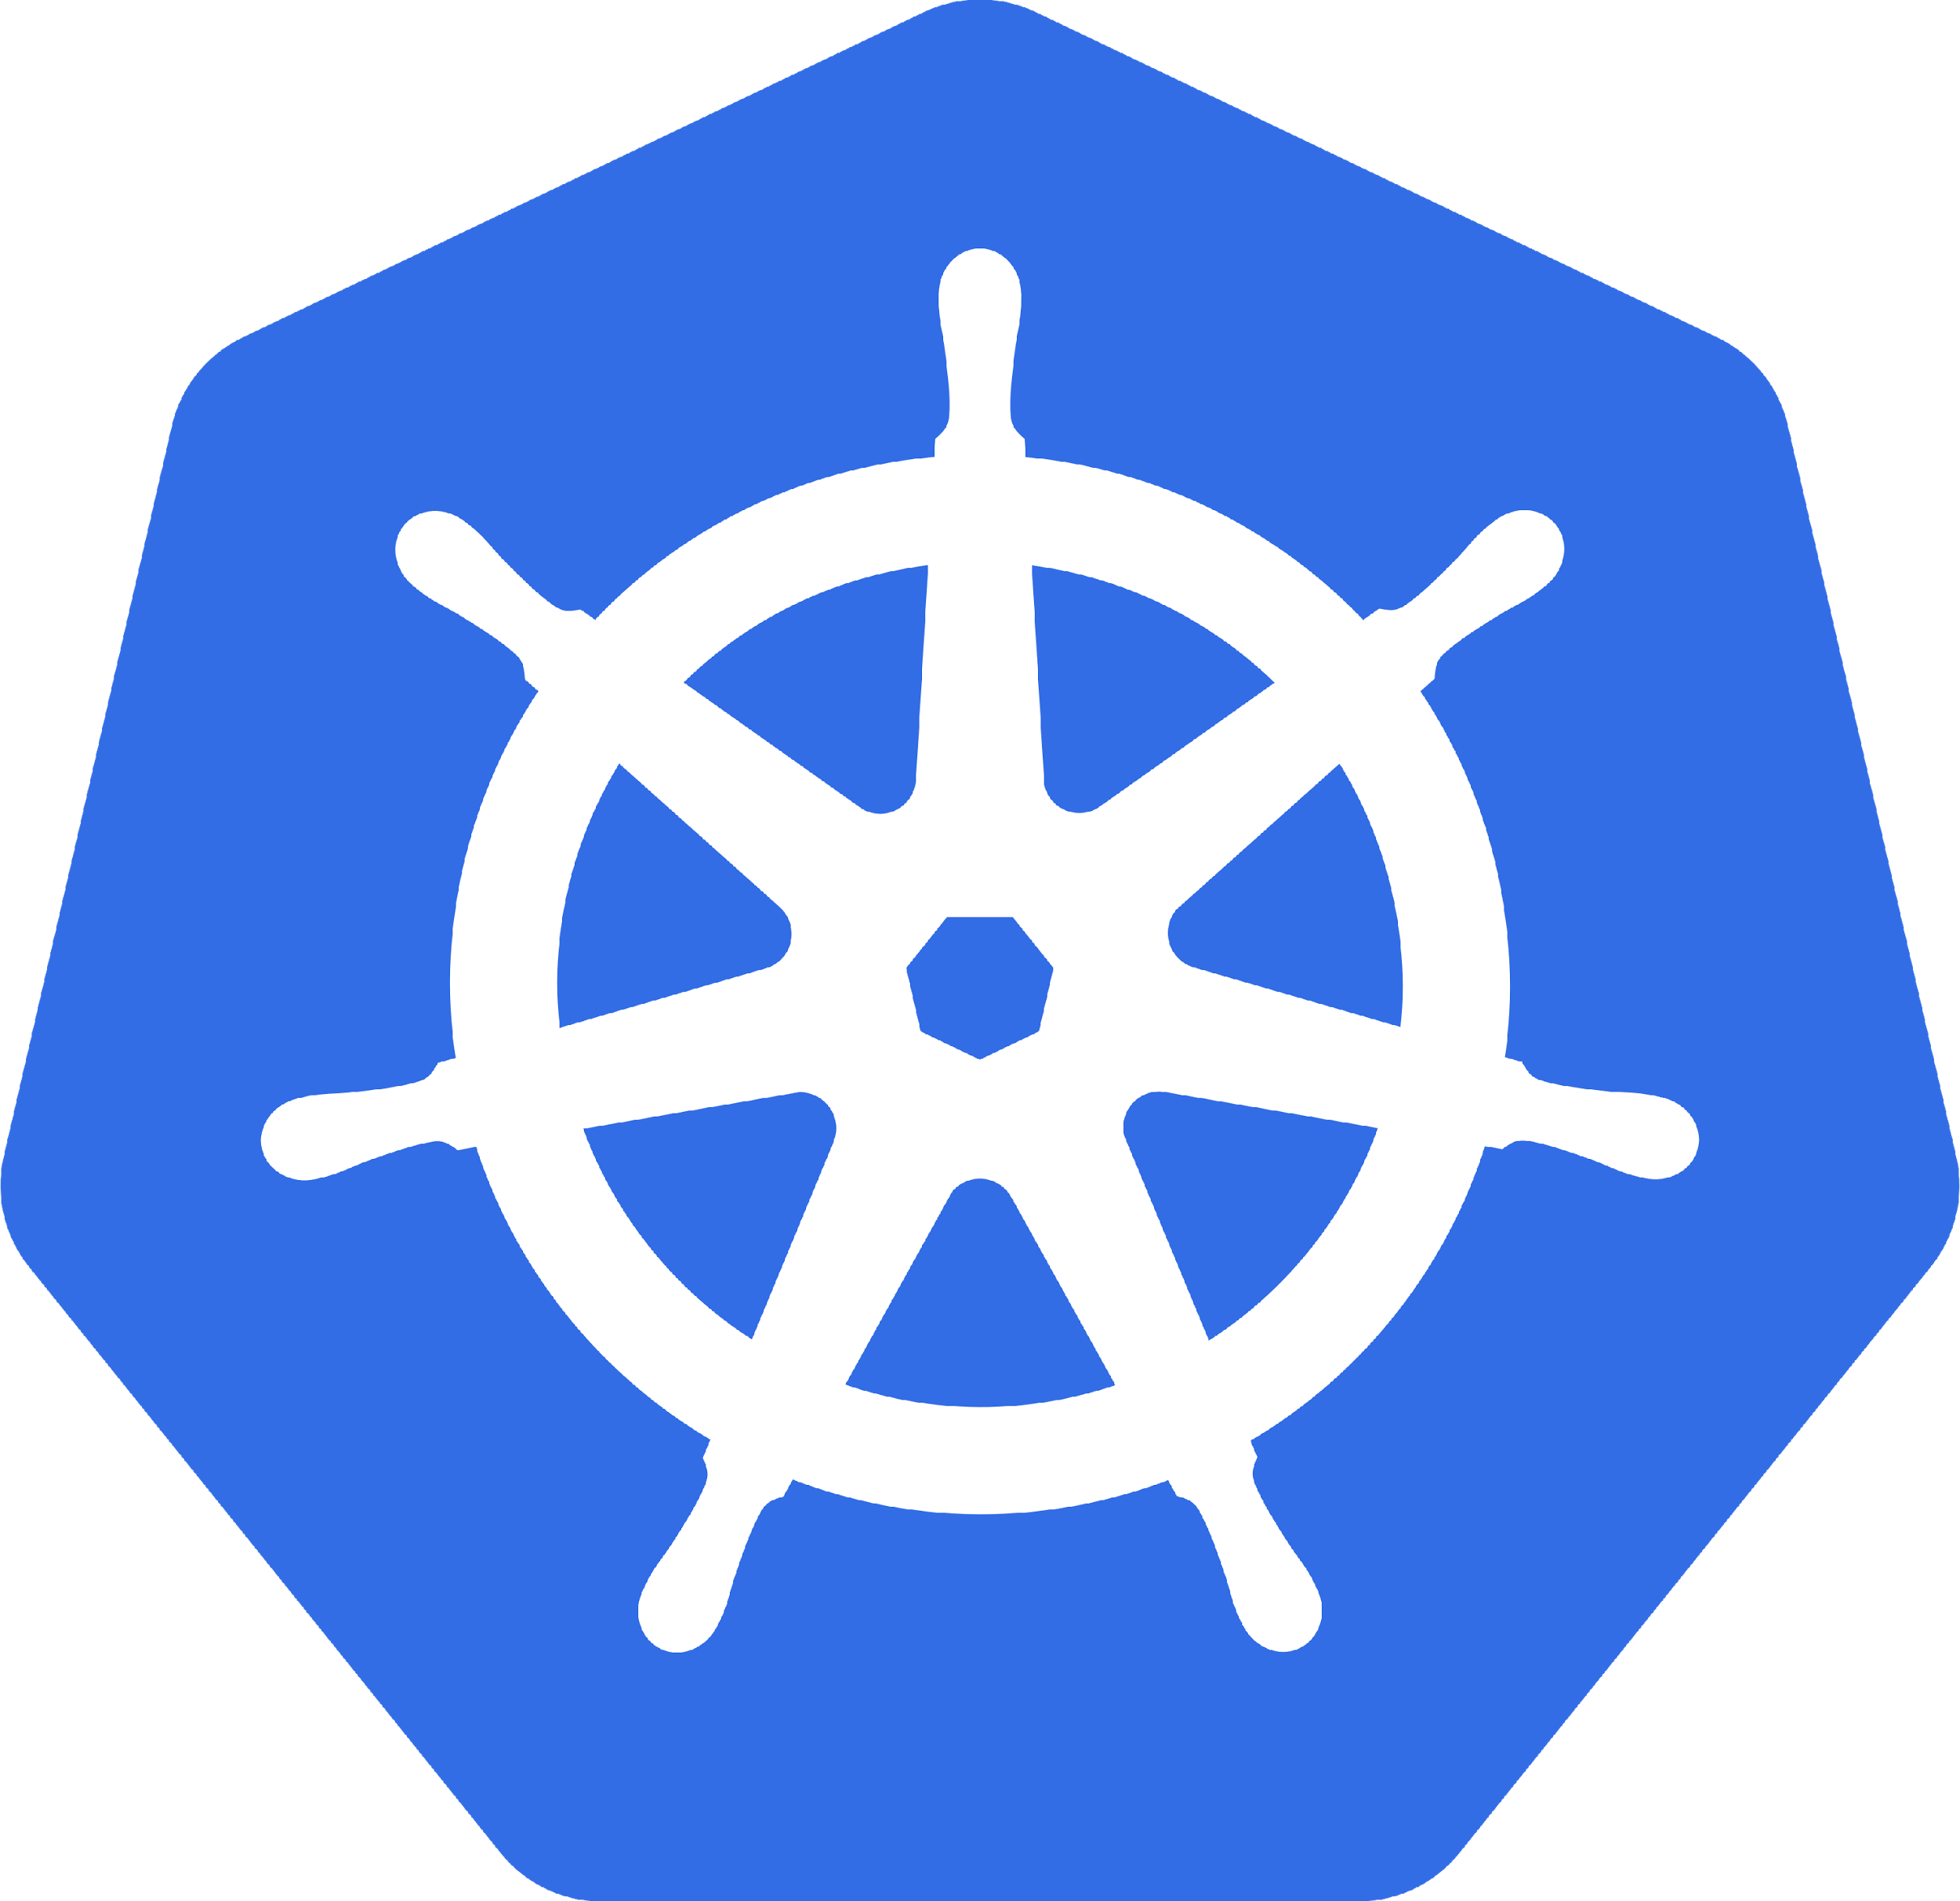
What is Kubernetes
Orchestrates Containers
That’s it? That’s all it does!

Slide 5
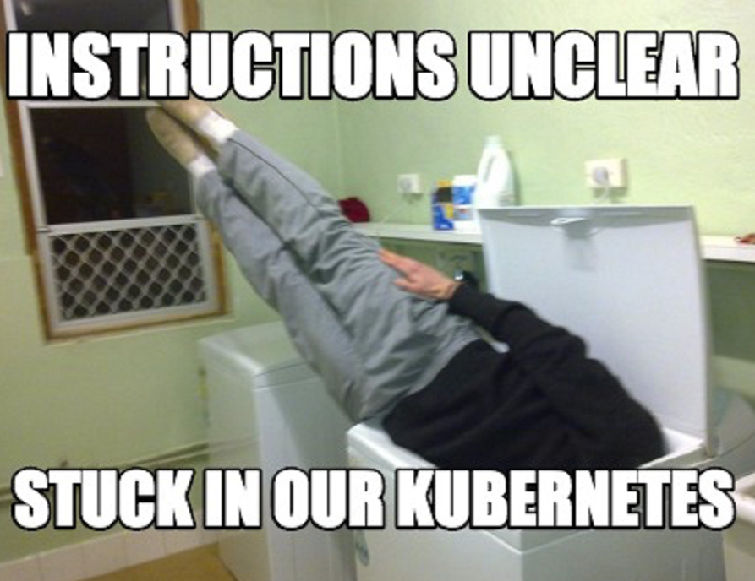
It Is Complex
Scale
Kubernetes Reference API
What is Kubernetes Physically Speaking?

Slide 6
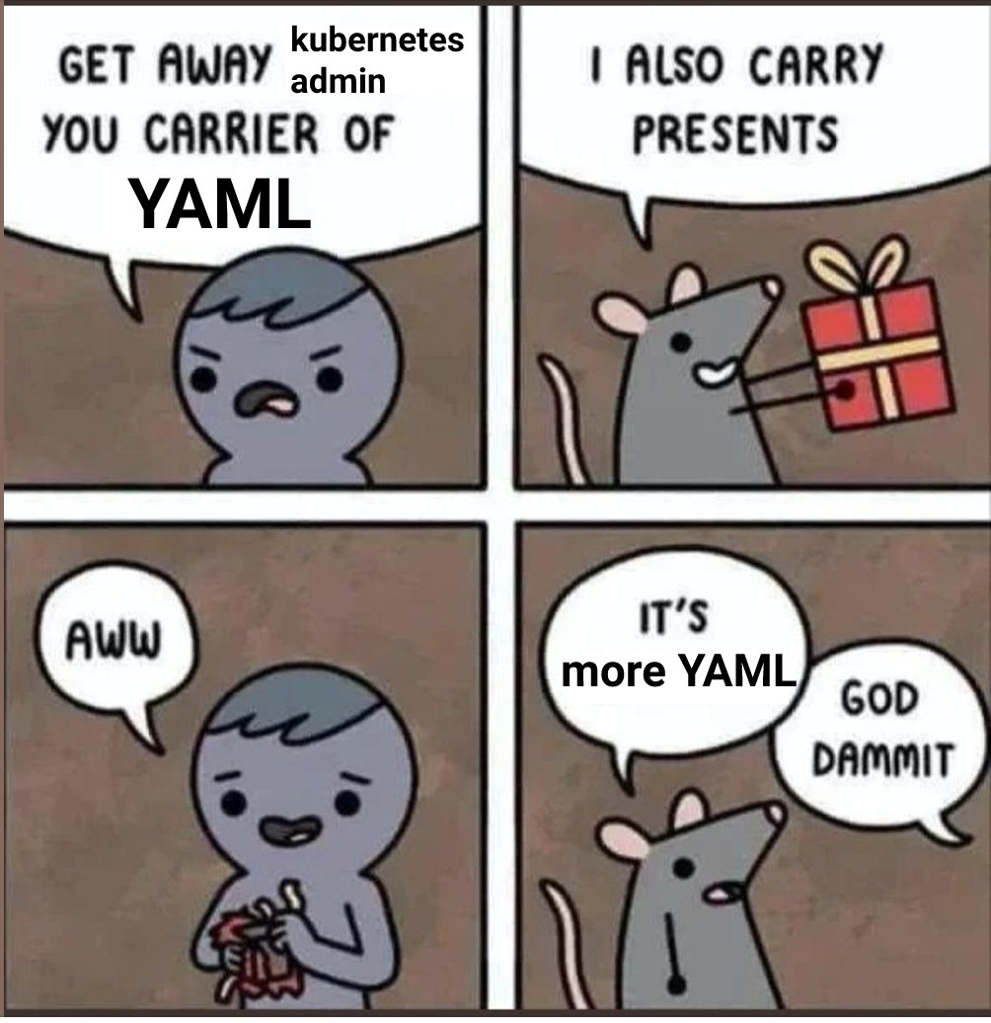
It Is Complex
https://twitter.com/memenetes/status/1633876132855709697

Slide 7
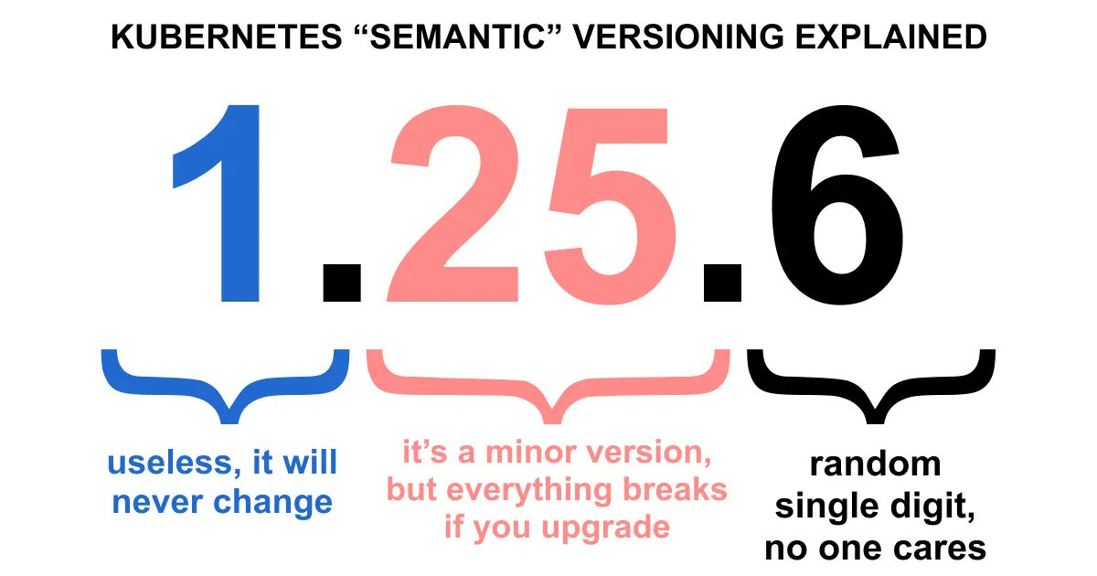
It Is Complex
https://twitter.com/memenetes/status/1631339227785969664

Slide 8

Why Should Developers care?
Containerized Applications
Breaking the Monolith
It’s the Substrate

Slide 9
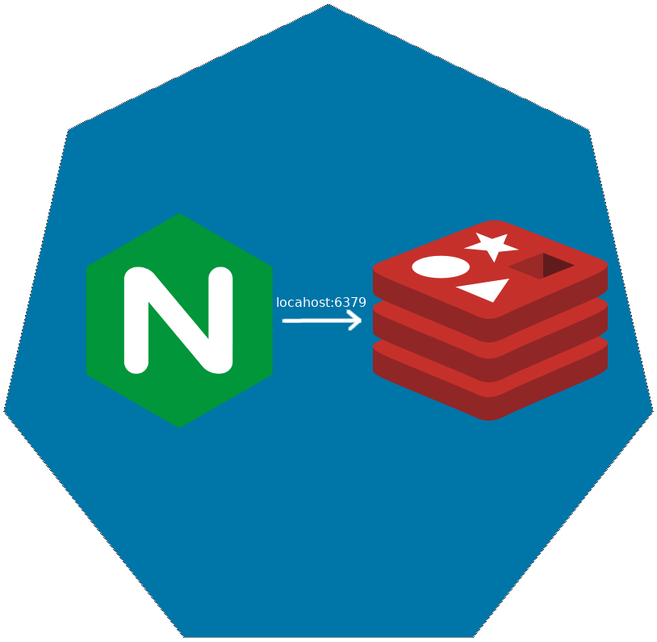
Pod
Co-scheduled
Shared Network Namespace
Shared Files System

Slide 10

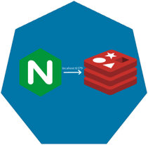
ReplicaSet

Slide 11

ReplicaSet

Slide 12
ReplicaSet

Slide 13
Deployments

Slide 14
Deployments

Slide 15
Deployments

Slide 16
Deployments

Slide 17
Deployments

Slide 18
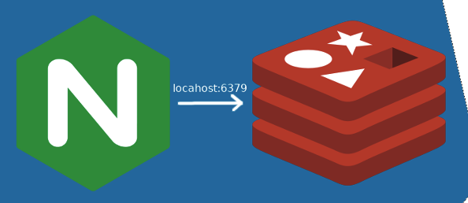
How are these Connected?
Deployment
ReplicaSet
Manages
Manages
Pod
Manages
Containers

Slide 19
How are these Connected?
Deployment
ReplicaSet
Selector
app=nginx
Pod
Labels
app=nginx
Selector
app=nginx
Labels
app=nginx
Containers

Slide 20
How are these Connected?
Deployment
ReplicaSet
Selector
app=nginx
Pod
Labels
app=nginx
Selector
arbitrary=whatevs
Labels
arbitrary=whatevs
Containers

Slide 21
Let’s Take a look
Deployment
ReplicaSet
Pod
kubectl create deploy –-image=nginx
Containers

Slide 22
Services
Define a DNS entry that can be used to refer to a group of pods
Provide a consistent endpoint for the group of pods
Different types: nodePort, clusterIP, loadbalancer

Slide 23


Services (Node Port)
192.168.0.[1-3]:32000

Slide 24
Services (Load Balancer)
Public IP:80

Slide 25
Config Maps & Secrets
Allow storing of arbitrary configuration values and files
Exposed in pods as either environment variables or as local storage
Decoupled storage of configuration from pod spec

Slide 26
Config Maps & Secrets
apiVersion: v1
kind: ConfigMap
metadata:
name: dev-config
namespace: default
data:
Item1: dev-stuff
Item2: more dev stuff
apiVersion: v1
kind: ConfigMap
metadata:
name: qa-config
namespace: default
data:
Item1: qa-stuff
Item2: more qa stuff
apiVersion: v1
kind: ConfigMap
metadata:
name: prod-config
namespace: default
data:
Item1: prod-stuff
Item2: more prod stuff

Slide 27
Ingresses
Define how traffic outside the cluster is routed to inside the cluster
Used to expose Kubernetes services to the world
Route traffic to internal services based on factors such as host and path
Ingress is usually implemented by a load balancer (Nginx, HAProxy, AWS ELB, etc…)

Slide 28

Ingresses
Ingress Controller
https://my-nginx-app.cluster.com https://cluster.com/my-nginx-app

Slide 29
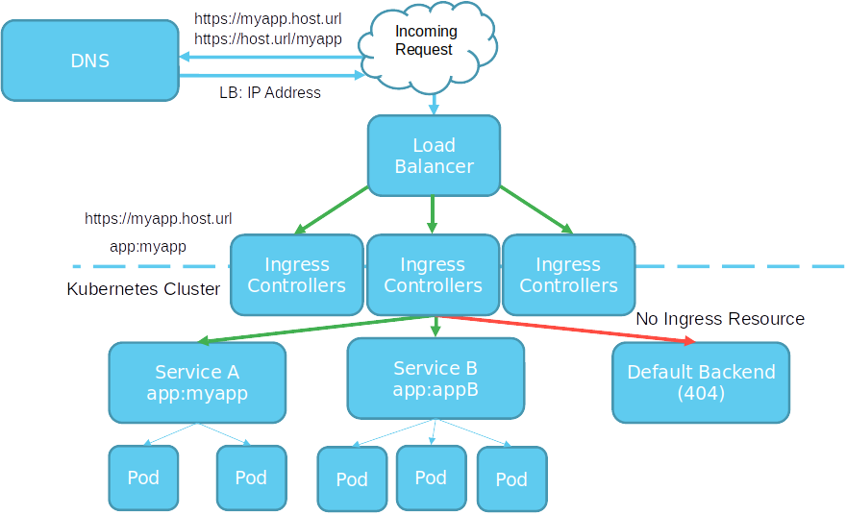

Slide 30
Tools
Running Kubernetes Locally
Running Kubernetes In The Cloud
Dealing with Scale

Slide 31
Running Kubernetes Locally
K3d
K9s
Rancher
Docker
Kind
KWOK

Slide 32
Running Kubernetes In the Cloud
AKS
EKS
GKE
Digital Ocean
Linode

Slide 33
Dealing with Scale
Find a framework you like
ELK
PLG
Don’t Over Alert

Slide 34
Packaging and Supply Chain Security
Chainguard
Zarf

Slide 35

The Kitchen Sink
https://landscape.cncf.io/
https://twitter.com/memenetes/status/1637861860039876624

Slide 36
Get In Touch
#Zarf at https://slack.kubernetes.io
@defenseunicorns
Defense Unicorns
@JvB
@jasonvanbrackel
jasonvanbrackel

Slide 38

Get This Powerpoint
https://github.com/JasonvanBrackel/OSS2023.git

Slide 40


Check out Zarf!
https://zarf.dev/

